Slide 1
CS2040 Lab#03 B03

Slide 2
CS2040 Lab #02
Qn1. Football

Slide 3
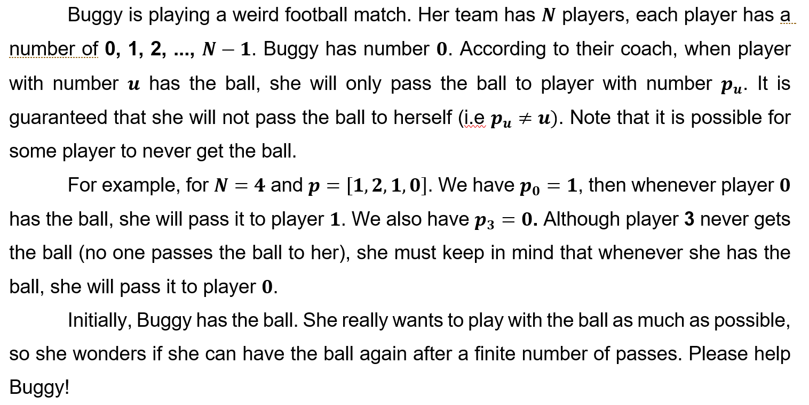
Q1 Football

Slide 4
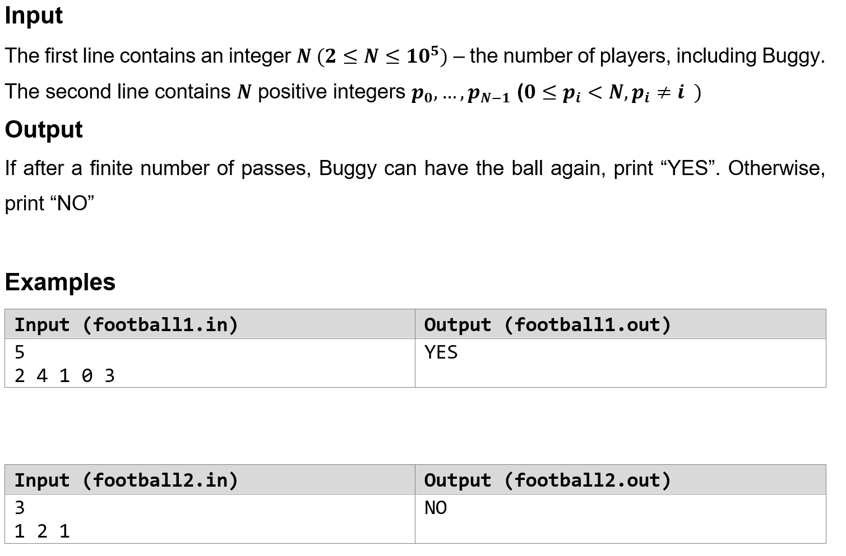
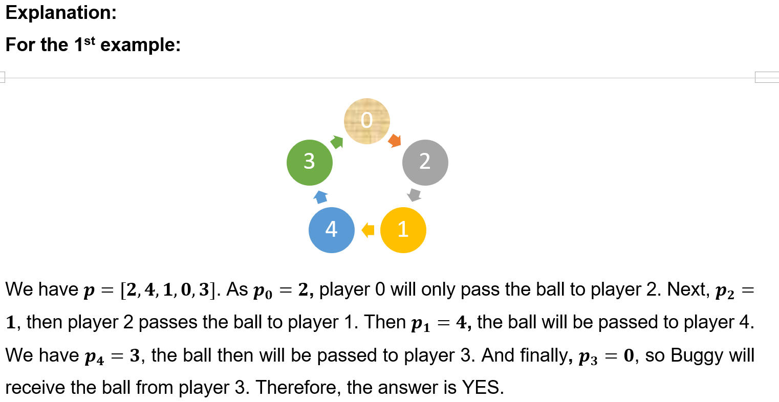
Q1 Football

Slide 5
Ideas
Array[n] p : read in and store who the player i will pass ball to.
Array[n] record: record[i] represents the times the player i get the ball.
Use while loop to simulate the game and record[i]++ when player i gets the ball, check whether records[i] == 2
If records[i] == 2 and i == 0, YES
Else, NO

Slide 6
CS2040 Lab #02
Qn2. Editor

Slide 7


Problem
Make a text editor for Uncle Grandpa. The text editor uses a cursor to navigate. It also has a string buffer to support copy-paste operations. Return the string after processing all operations.
Constraints:
Input string, S
Number of operations, n

Slide 8
Valid Operations
Operation | Function
R | Increase the position of the cursor by 1. If the cursor is already at the last position, nothing changes.
L | Decrease the position of the cursor by 1. If the cursor is already at the first position, nothing changes.
C k | Copy substring of min(k, cursor to end of string) length to buffer, starting from character immediate right of cursor.
P | Insert buffer content to position immediate left of cursor. Empty buffer.
I c | Insert 1 character to position immediate left of cursor.
B | Delete 1 character to position immediate left of cursor. If the cursor is at position 0, nothing changes.

Slide 9
Possible Data Structure
Option #1 - Java API
LinkedList <Character> editor
ListIterator <Character> cursor
LinkedList <Character> buffer
Option #2 - self implement DLL
DLL for editor
Node cursor for pointer ref
LinkedList <Character> buffer

Slide 10
Common mistakes
Don’t concatenate Strings using “+”! It takes O(n) times. Use alternative ways such as Stringbuilder or just print out character by character.
Don’t use LinkedList.get() provided by Java. O(n) time complexity.

Slide 11
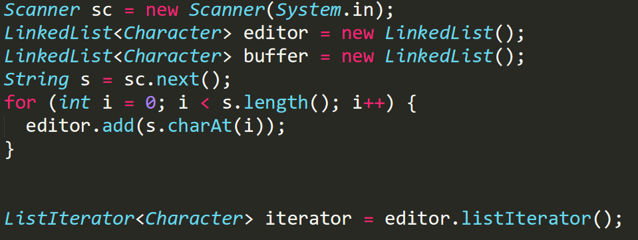
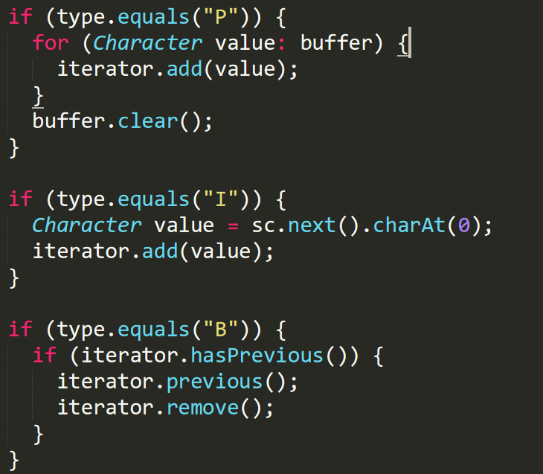
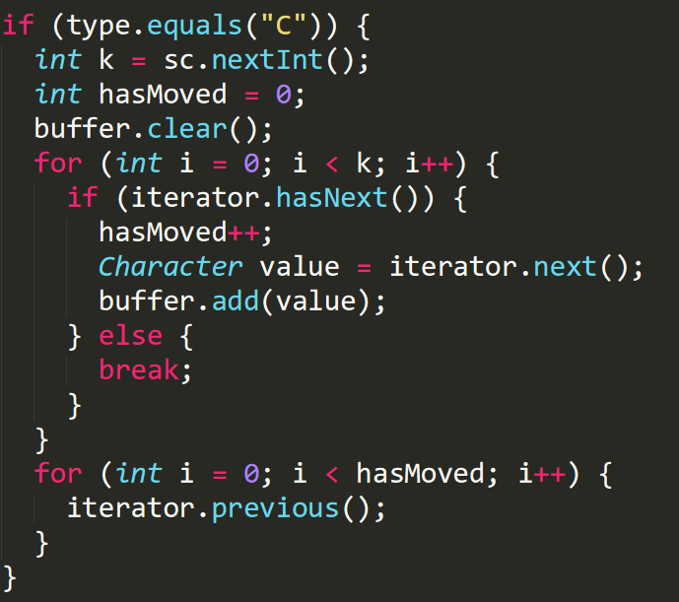
Sample solution

Slide 12
Visualgo quiz

Slide 13
Visualgo quiz
i. Identify yourselves, using a phone camera or webcam to show your faces and your surrounding to ensure there is no one else with you.
ii. Activate screen recording. Recording should not be turned off until the result of the quiz is given by the Visualgo system.
iii. Open a blank page where you can enter your name and student number.
iv. Submit this recording to me at the end of the quiz. When you submit, please send me your score together. This will facilitate record of your score.

Slide 14
Visualgo quiz
https://visualgo.net/training?diff=hard&n=15&tl=10&module=linkedlist

Slide 15
CS2040 Lab #03
Qn1. Uncle Grandpa and windows

Slide 16
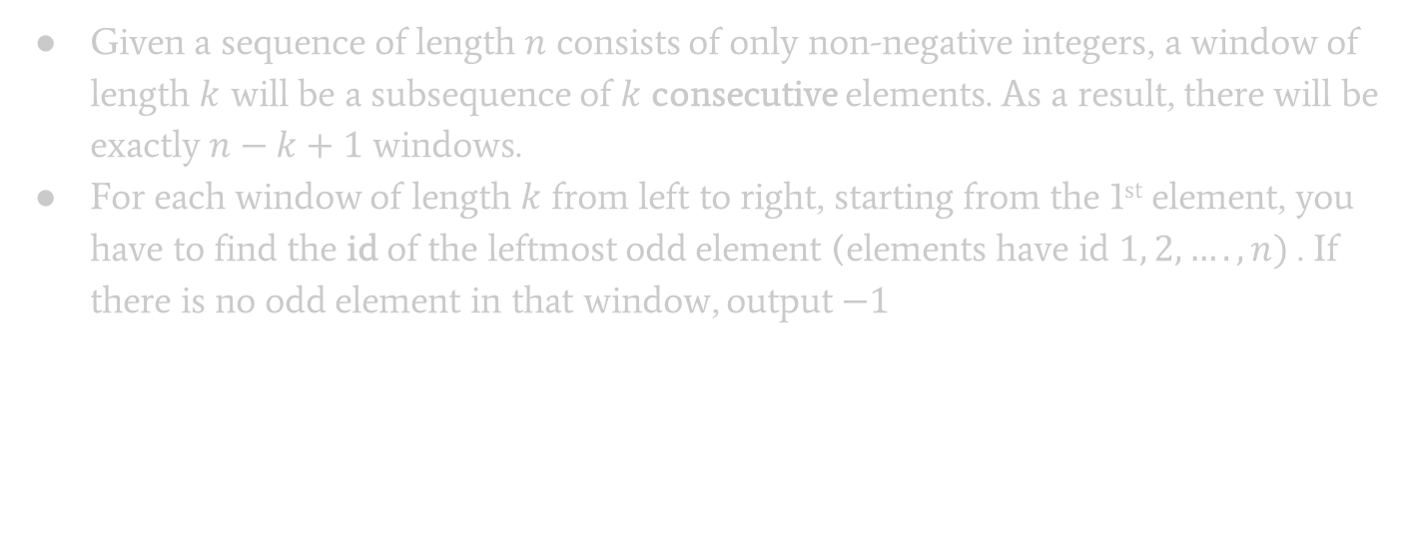
Problem Statement:
Given a sequence of length $n$ consists of only non-negative integers, a window of length $k$ will be a subsequence of $k$ consecutive elements. As a result, there will be exactly $n−k+1$ windows.
For each window of length $k$ from left to right, starting from the 1st element, you have to find the id of the leftmost odd element (elements have id $1, 2, …., n)$. If there is no odd element in that window, output $−1$

Slide 17
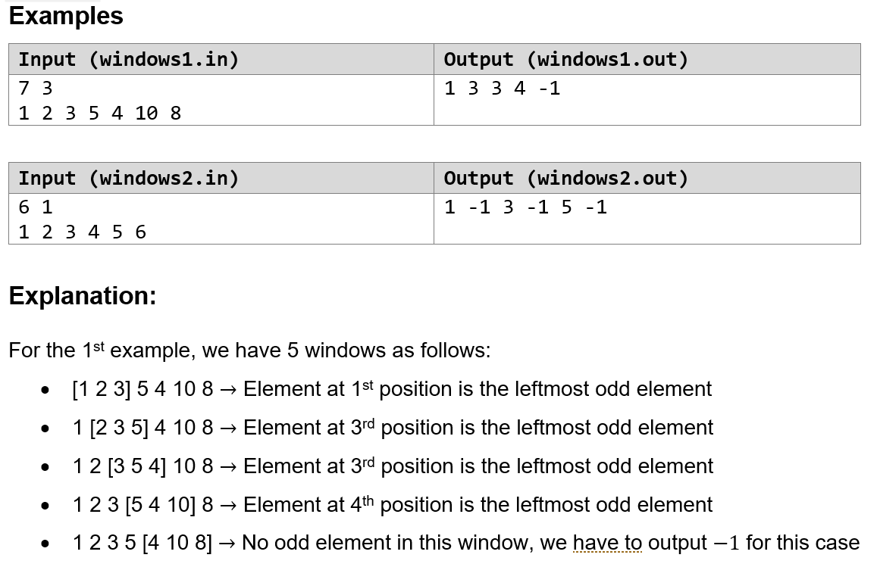
Examples

Slide 18
Problem Breakdown:
Input:
2 Integers: Number of elements (N) and window size (K)
Sequence with N integers
Output:
N - K + 1 Integers : each representing the ID of the left most odd element of each window.

Slide 19
Things to note:
Planning:
ID is equals to index + 1
If all elements in the given window are even, output -1 as the ID
What data structure to use?
How do you simulate a sliding window?
What is useful about the information for only having to output the odd elements?
How to not print extra space for the last window?

Slide 20
CS2040 Lab #03
Qn2. Feeding Frenzy

Slide 21

PROBLEM
Initially, there are n full fishes in the pond, represented by their integer size
m hungry fishes enter the pond, sequentially.
Each time a hungry fish enters, it eats all the fish that are strictly smaller than itself and its size increase by the eaten fish’s size
It will become full once it finished eating all (strictly) smaller fishes
Next fish will then be added (once current hungry fish becomes full)

Slide 22
INPUT
First line contains two integers:
n: number of full fishes initially in the pond
m: number of hungry fishes that will be added to the pond sequentially
Second line contains a list of n full fishes, each represented by their size (listed in ascending order)
Third line contains a list of m hungry fishes, each represented by their size

Slide 23
OUTPUT
A single line consisting of a list of full fishes that remains in the pond, listed in ascending order

Slide 24
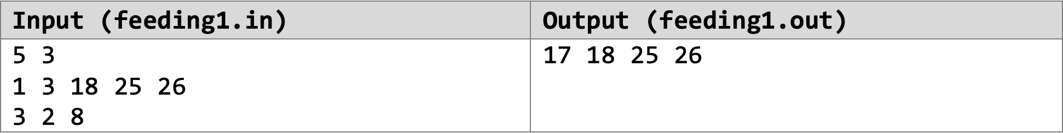
SAMPLE TEST CASE
There are 3 hungry fishes that will be placed in the pond
Output remaining full fishes in the pond, listed in ascending order
There are 5 full fishes in the pond, initially
List of full fishes in the pond initially, listed in ascending order
List of hungry fishes that will be placed in the pond sequentially

Slide 25
Sequence:
Initially, the five fishes in the pond are all full: 1 3 18 25 26
Next comes a hungry fish of size 3 into the pond
It then eats a fish of size 1. It now has size 3 + 1 = 4
It then eats a fish of size 3. It now has size 4 + 3 = 7
It can no longer eat any fish in the pond, so it becomes a full fish.
Next comes a hungry fish of size 2
It can’t eat any fish, so it just becomes a full fish.
Next comes a hungry fish of size 8
It then eats a fish of size 2. It now has size 8 + 2 = 10
It then eats a fish of size 7. It now has size 10 + 7 = 17
It can no longer eat any fish in the pond, so it becomes a full fish.
Full fishes remaining: 3 18 25 26
Full fishes remaining: 18 25 26
Full fishes remaining: 7 18 25 26
Full fishes remaining: 2 7 18 25 26
Full fishes remaining: 7 18 25 26
Full fishes remaining: 18 25 26
Full fishes remaining: 17 18 25 26

Slide 26
DATA STRUCTURES
Allowed:
Java Queue API / Java LinkedList API
Java Stack API
Self-Implemented Stack / Queue (must behave like one!)
Other Data Structures are strictly forbidden
That means Heaps (PriorityQueue) are not allowed!

Slide 27
METHODS
Methods for Queue: // FIFO – First-In-First-Out
poll() removes the frontmost element from queue
offer() adds an element to the back of the queue
isEmpty()
Methods for Stack: // LIFO – Last-In-First-Out
pop(), push(), isEmpty()

Slide 28
CS2040 Lab #03
Qn3. Uncle Grandpa and Cake Cutting
(Difficult question. Please do not be demoralized if you do not understand it straight away.)

Slide 29
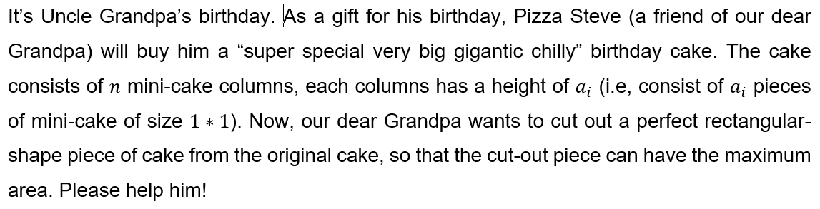
Problem Statement
Find the largest possible rectangle in a given histogram

Slide 30
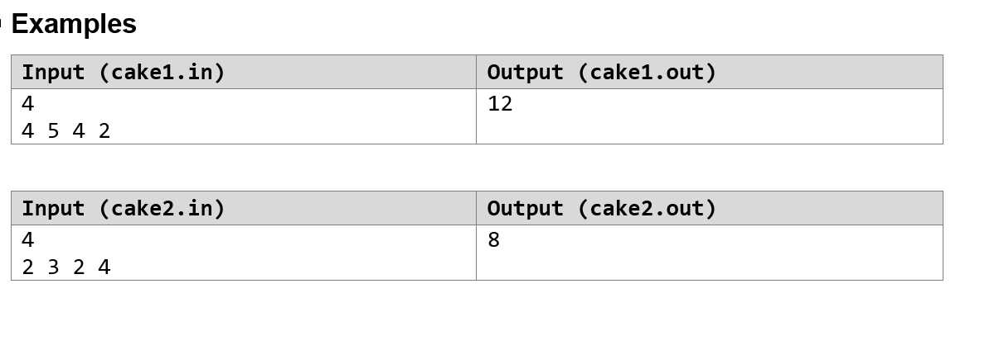
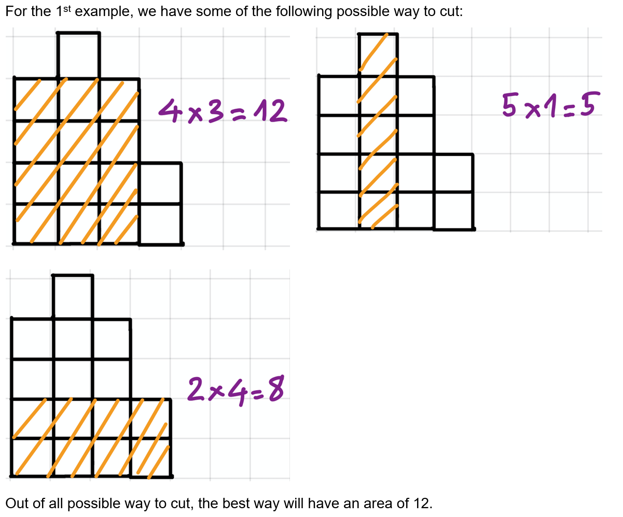
Example
Find the largest possible rectangle in a given histogram

Slide 31
Brute force solution
For all columns, find the max area that it can make.
Use a nested loop to accomplish this

Slide 32
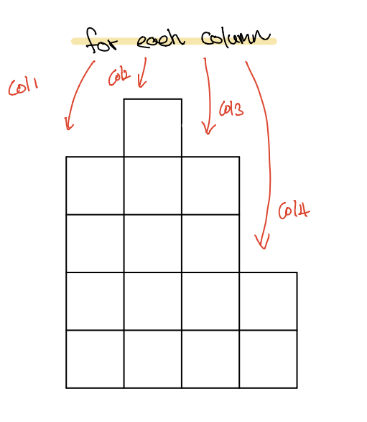
Brute force solution
How do you loop through each
column?
Best data structure to use?

Slide 33
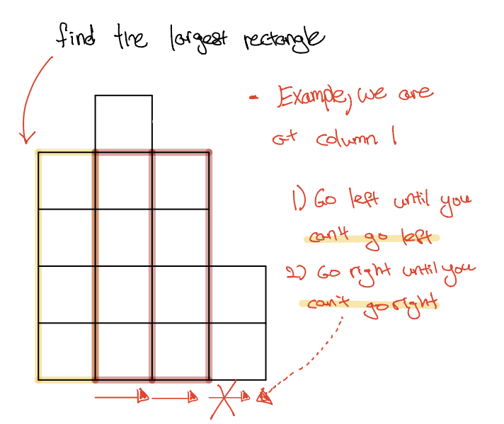
Brute force solution
How do you go left and right?
What does it mean to not be able
to go left/right?
How do you update the max rectangle?

Slide 34
Brute force Time Complexity
Time complexity of O(n^2)
Notice we may recheck each rectangle more than once.
We should aim to minimise this check to just one check!

Slide 35
Basic ideas
For each column, it generates the maximum area by stretching out to the leftmost and to the rightmost.
Use two arrays to record how far a column can stretch.
Loop through from left to right. Use a stack to store the columns which are in ascending order. For each column, we pop out all the columns greater than it. After this process, the leftmost column it can stretch out to is the one on the top of the stack.
Similarly we loop through from right to left.
At last, loop through all the columns and get the maximum areas each one can stretch.

Slide 36
Demonstration

